Slide 1
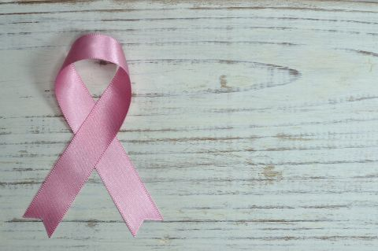


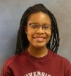
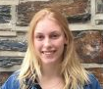

Data+ 2018:
Project #6 Women’s Spaces
July Update
Project Lead: Dr. Charlotte Sussman
Project Manager: Michelle Sroka
Undergraduates: Alexis Malone, Sandra Luksic & Nathan Liang

Slide 2
Outline
Progress
Text Analysis
Algorithmic Gender Bias
Image Analysis
Moving Forward

Slide 3


Timeline
Research Framework
Data Cleaning
Exploratory Data Analysis
Weeks 1-2
Weeks 3-4
Weeks 5-6
Week 7
Week 8
Weeks 9-10
Data Collection
Deep Text Analysis
Data Visualization & Presentation
Notes:
Research Framework: Define research questions, goals and methodology
Data Collection (text and images): Download cover, Manual transcription , Facial recognition software (Microsoft Azure, Compile in R)
Data Analysis: Clean dataset, Regression, ANOVA, SEM in R and JASP
Deep Text Analysis: 3-way literary/psychological analysis of magazine text
Exploratory Analyses: Further statistical analyses guided by deep text analysis

Slide 4
Since you’ve been gone...
Analyzing messages and narratives told by women’s magazines
Collecting text and image data of 5 magazines
Cosmopolitan
Seventeen
Essence
Good Housekeeping
New: Esquire
New Tools: Microsoft Azure Face Detect, Python, R-Shiny, Tableau
Notes:
Big takeaways: audiences are different
Last presentation, we asked if and how woman’s magazine covers empower women. We started with the idea that magazine covers and media have influence. Their words and images are representation, they set standards, they tell us what we should care about. Women’s magazines are written by women, for women - they talk about sexual pleasure, periods, boobs, motherhood, relationships - but just because they talk about women's “issues”, does this mean they have women’s best interests in mind?

Slide 5
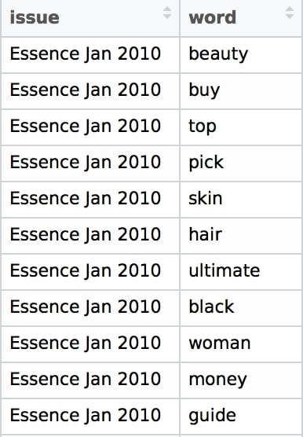
Text Data
Transcribed text from 500+ magazine covers
Cleaned and compiled text data
Notes:
Stop words
Stemming
Removing numbers and magazine names

Slide 6
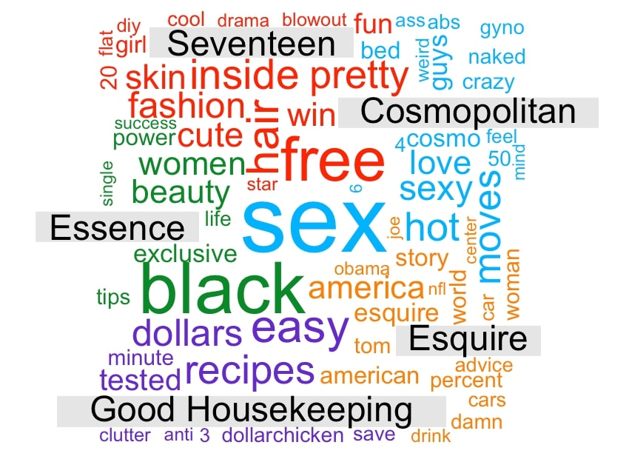

Slide 7
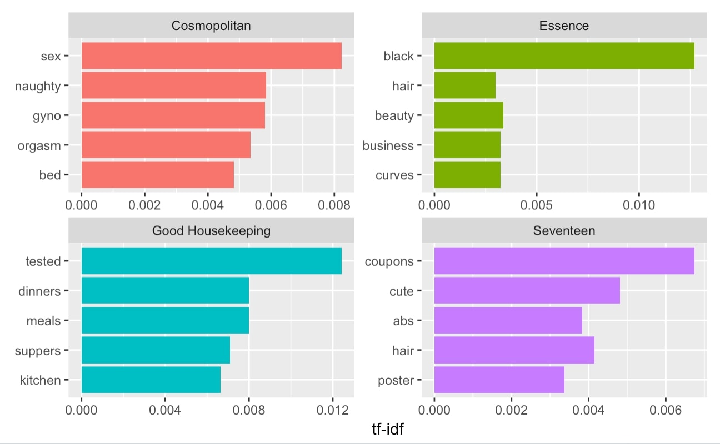
Notes:
We would be mistaken if we thought all women had the same needs. Cosmopolitan is speaking to a subset of white, middle-upper class readers. Magazines for younger girls, older women, and black women speak to different audiences. And these different audiences and different needs requires selling different products and telling different stories. Seventeen knows its average reader is 16 years old and her weekly allowance is pennies. So they advertise “budget buys” and “freebies inside” to get them to buy the magazine..

Slide 8
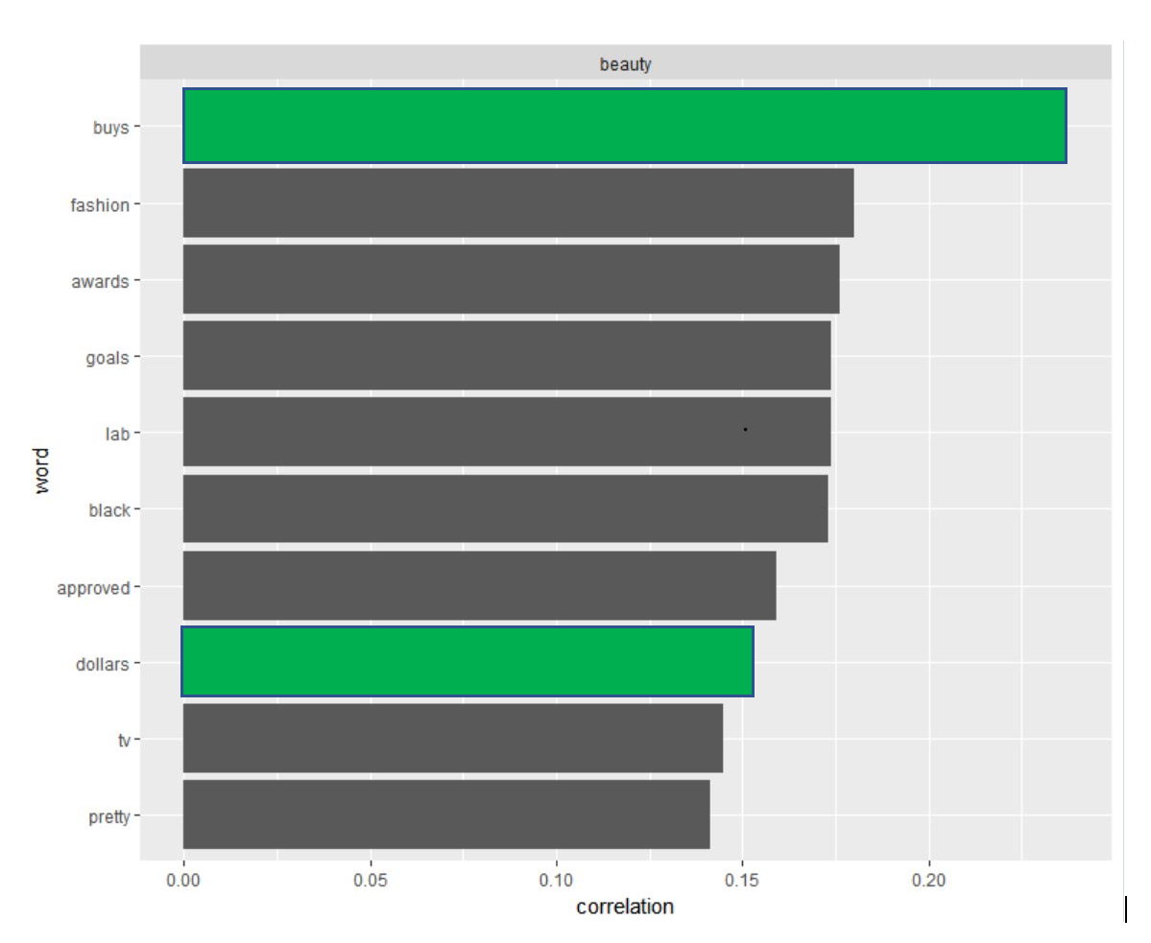
Which came first? Beauty or the beauty product?
Notes:
To generate demand for beauty products, advertisers must first generate a demand for beauty. This is no problem: a large part of woman’s value to society is as a beauty and sex object. Feminists have pushed against this idea, but women’s magazines continue to promote them.
Magazines are also businesses. Businesses want to make a profit. Subscribers to Cosmo aren’t just readers, they are consumers. Women’s magazines may seek to empower women, but they must financially disempower them to survive. Advertising aimed at women has roots in a realization that women make around 50 to 70% of a households purchasing decisions. So what do women’s magazines do? They connect the goal of female empowerment to products. They say - “be beautiful! (by buying this dress).” They say “Have amazing sex (by buying this magazine for tips!)” Add data correlation here. Women’s magazines see there is an unfilled demand for women to be empowered, and they supply that demand through both abstract articles/stories/advice AND tangible products.

Slide 9
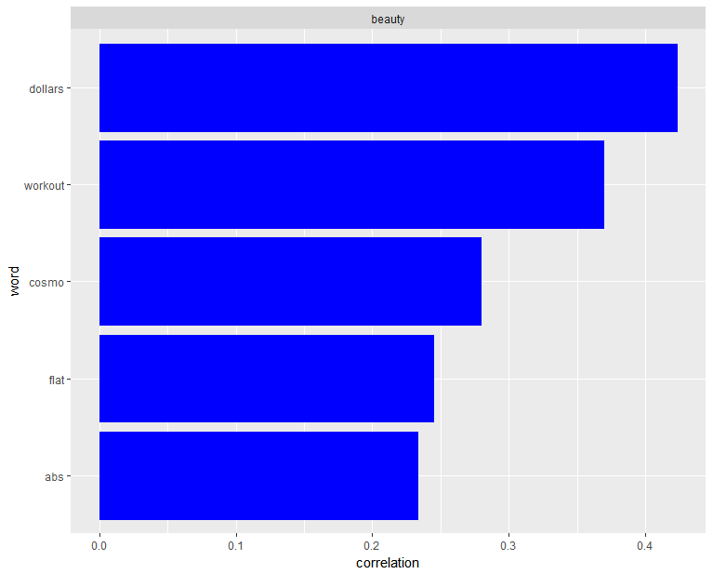
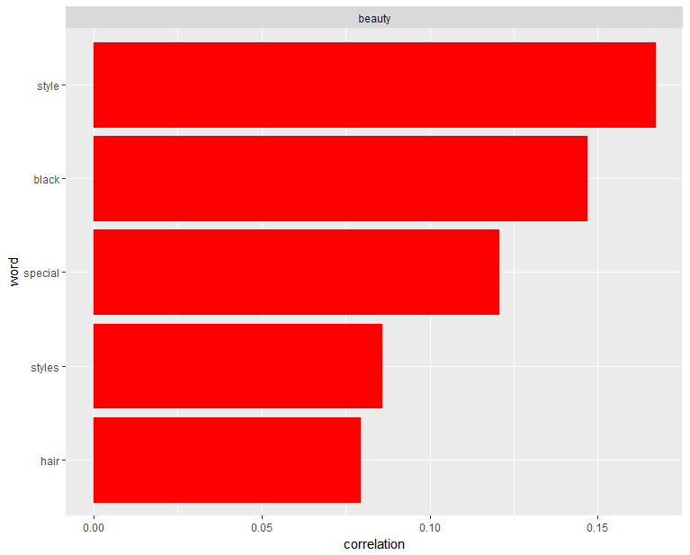
“Beauty” in Cosmopolitan vs. Essence

Slide 10
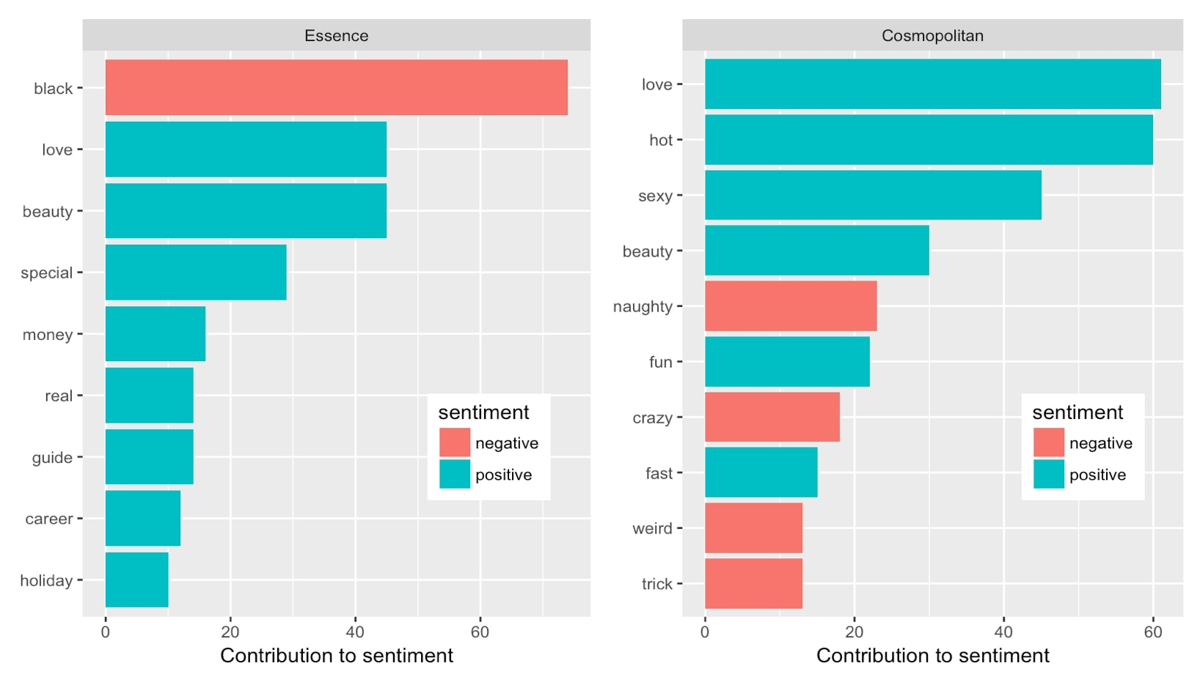
Text in Context
Notes:
**Sentiment analysis not particularly helpful for our purposes, considering certain words have different meanings in the context of these magazines (black, naughty, weird categorized as negative words doesn’t tell us much)
Next steps: developing our own “sentiment analysis” and categorizing certain words as body positive/negative, empowering, sexist, etc… This may pave the way for us to determine how magazines can be more empowering (i.e. reprogramming the ways we speak about women and the words we use around women)
Body positivity

Slide 11
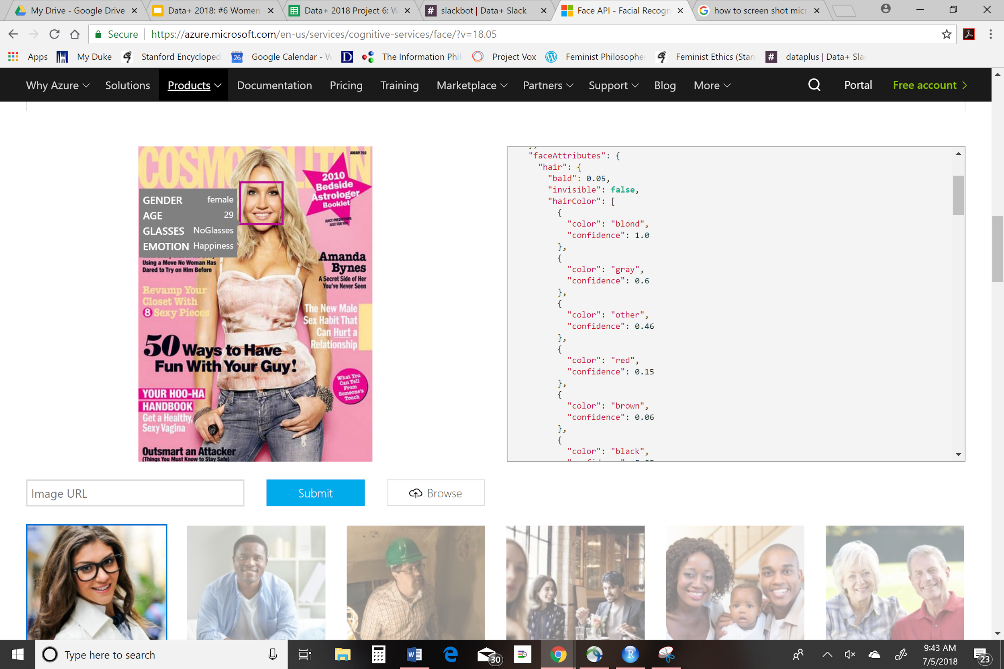
Image Data
...
Notes:
Microsoft Azure Face Detect

Slide 12
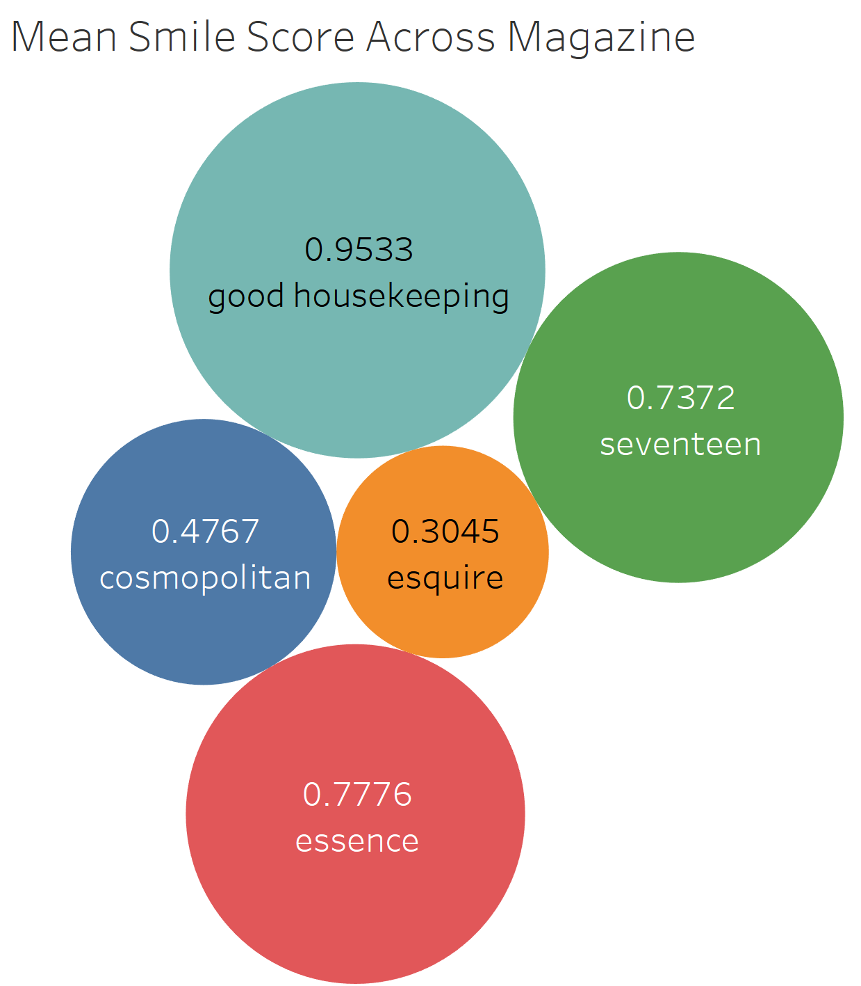
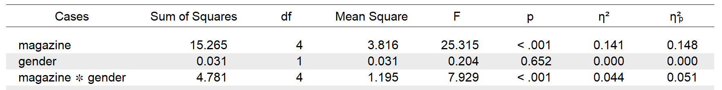
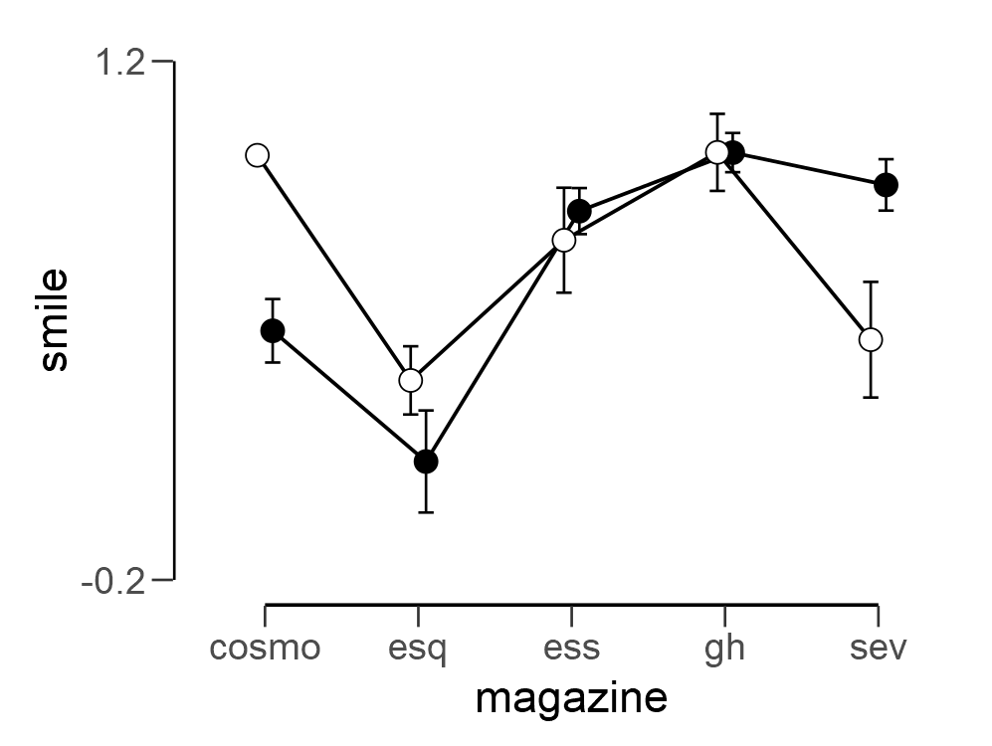
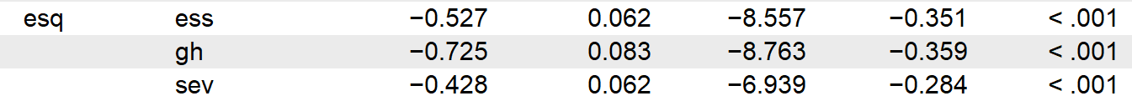
Smile Differences Across Magazines
Two-Way ANOVA: Smile
Male = 0
Female = 1
Post-Hoc Analyses: Magazine

Slide 13
Moving Forward
More complex text and image analysis
Grounded in advertising, racial, class data
Interactive website and making data/code open source
Tracking bias and changing gendered words in existing sentiment analysis

Slide 14
Questions?
Special Thanks To:
John Little Eric Monson Mark Thomas Drew Keener
______________________
Liz Milewicz
Will Shaw ______________________
Kelly Wooten
Joshua Rowley
Dr. David Siegel
Dr. Mine Cetinkaya-Rundel

